Slide 1
THANK YOU FOR JOINING US TODAY!
Please stay on the line as we wait for more participants to join the webinar.

Slide 2
COVID-19 VACCINE BRIEFING Development, Safety, and Distribution
John Schulte
Vice President of Quality Improvement
ARGENTUM
TJ Griffin
Chief Pharmacy Officer
PharMerica

Slide 3
Before We Start
The link to the recording of this webinar will be emailed to all attendees three hours after the end of the webinar today. In case of any audio issues, please raise your hand using the GoTo Webinar tool and we will reach out on a case-by-case basis. In many cases, using your phone for your audio choice yields the best results. We will be allowing time for questions at the end of the presentation. However, all attendees will be placed on mute for the duration of the presentation. We will monitor the Chat Window for questions as they are submitted throughout the webinar. For any questions after the time of the webinar, please email pharmerica@pharmerica.com and questions will be channeled to the correct individual(s).

Slide 4
Learning Objectives
Outline the steps taken to develop safe and effective vaccines, including post-licensure surveillance
Review the FDA’s track record for vaccine approval
Understand the types of vaccine under late-stage development within the U.S.
Get caught up with findings from leading vaccine development efforts in the U.S., including data related to reactogenicity and immunogenicity
Prepare to build support for vaccination from across industry stakeholders
Look at vaccine quality and the processes established ensuring seamless vaccine distribution, administration and reporting

Slide 5
Speaker Introductions
John Schulte, Vice President of Quality Improvement, ARGENTUM
John Schulte has led and managed not for profit trade associations for more than 20 years, working with volunteer subject matter experts to collaboratively develop solutions for diverse industries such as industrial and commercial water treatment, heating and air conditioning, air duct cleaning, energy management, building commissioning, and most recently, senior living.
TJ Griffin, R.Ph, Chief Pharmacy Officer, PharMerica
T.J. Griffin is Chief Pharmacy Officer at PharMerica. T.J. is a seasoned, healthcare executive with 30 years in long-term care and retail pharmacy management. In his current role, he helps deliver on the PharMerica promise of Care, Commitment and Collaboration by maintaining the highest quality standards in the industry through innovative pharmacy operations and clinical excellence.

Slide 6
Safe and Effective Vaccine Development
Key Points:
No vaccine is 100% effective
No vaccine is 100% safe
GOAL: Develop a vaccine that maximizes the benefit and minimizes the risk

Slide 7
Safe and Effective Vaccine Development
 | PRE-CLINICAL TRIAL | PHASE 1 | PHASE 2 | PHASE 3 | PHASE 4 (POST-MARKETING)
SUBJECTS | Trials in animals | Small number of healthy subjects (<100) | Larger number of subjects (100s) | Largest number of subjects (1,000s) More diverse population | General population, including those with immunocompromising conditions
OBJECTIVES | Safety Immunogenicity Feasibility | Safety Immunogenicity Safe dose range | Safety Immunogenicity | Safety (uncommon adverse events) Efficacy (how well vaccine prevents disease) | Safety (very rare adverse events) Effectiveness (how well vaccine prevents disease in general population over time
KEY POINTS | Critical step before proceeding to human trials | First human trial | Determine the final does and schedule | Typically randomized, controlled, double-blind trial | Post-licensure safety effectiveness surveillance

Slide 8
Safe and Effective Vaccine Development
POST-MARKETING SAFETY AND SURVEILLANCE
Vaccine Adverse Event Reporting System (VAERS)
Vaccine safety is monitored for several years after vaccines are marketed
This is necessary to identify rare adverse events
Example: You would need data from 1 million people to be able to see 100 to 200 rare adverse events that impact .001% to .002% of recipients.
Anybody can report into VAERS

Slide 9
Safe and Effective Vaccine Development
POST-MARKETING SAFETY AND SURVEILLANCE
Report an Adverse Event to VAERS
The above link provides information on how and where to report into VAERS.

Slide 10
Safe and Effective Vaccine Development
In the history of vaccines, 90 to 95% reveal their long-term side effects within 30 to 45 days after their final dose. (Dr. Fauci Says You Should Expect These COVID Vaccine Side Effects, November 30, 2020)

Slide 11
FDA Track Record for Vaccine Approval
STUDY: “Post-marketing Safety of Vaccines Approved by U.S. Food and Drug Administration”
This study considered vaccines approved by FDA from January 1, 1996 to December 31, 2015
There were 57 vaccines approved during this time frame
25 vaccines had one or more safety-related label modifications
32 did not have any modifications

Slide 12
FDA Track Record for Vaccine Approval
“Post-marketing Safety of Vaccines” (Continued)
For the vaccines that had safety-related label modifications, there were:
49 warnings and precautions
8 contraindications
1 safety-related vaccine withdrawal

Slide 13
FDA Track Record for Vaccine Approval
“Post-marketing Safety of Vaccines” (Continued)
Most safety-related issues were not serious
The most common issue triggering a label modification was expansion of population restrictions. This relates to populations which perhaps should not get the vaccine.
Immunocompromised patients (n = 9)
Pre-existing medical conditions (n = 5)
Premature infants (n = 4)
Pregnant women (n = 3)
Thirteen safety modifications were related to allergies; 12 of these were due to changes in latex-containing packaging
VAERS was the main source of data leading to modifications

Slide 14
FDA Track Record for Vaccine Approval
“Post-marketing Safety of Vaccines” (Continued)
Median time from vaccine approval to safety modifications was five years. For comparison:
Median time for safety-related label modification for medicines was 10 years
Median time for safety-related label modification for medical devices was even longer

Slide 15
FDA Track Record for Vaccine Approval
“Post-marketing Safety of Vaccines” (Continued)
The one vaccine withdrawn for safety-related issues was RotaShield, which was intended to address rotavirus
The RotaShield vaccine was withdrawn in 1998, less than two months after it was approved
Data collected through VAERS enabled detection of issues related to the rotavirus vaccine, underscoring the effectiveness of this system for post-marketing surveillance

Slide 16
FDA Track Record for Vaccine Approval
“Post-marketing Safety of Vaccines”
CONCLUSIONS
The vast majority of vaccines approved by FDA were found to be remarkably safe
The FDA approval process, and the VAERS surveillance program, are excellent

Slide 17
FDA Track Record for Vaccine Approval
“Post-marketing Safety of Vaccines”
Potential Opportunities for Improvement:
Collection of pre-approval data for special populations, including immunocompromised patients, those with pre-existing medical conditions, pregnant women, etc.
More focused post-marketing surveillance of special populations

Slide 18
Vaccine Types
Different vaccine technologies can be used to trigger the desired immune response:
Live Attenuated Vaccines (e.g., influenza, MMR)
Inactivated Vaccines (e.g. Hepatitis A, Polio)
Viral Vectored Vaccines (e.g., Ebola vaccine)
Recombinant-protein Vaccines (HIV, HPV)
mRNA Vaccines (advanced technology)

Slide 19
Vaccine Types
Of these various types, only three are anticipated for development of a COVID-19 vaccine in the U.S. at this time:
Viral-vectored Vaccines
Recombinant Protein Vaccines
mRNA Vaccines

Slide 20
Vaccine Types
Sidebar: “NEW” Vaccine Technology
Coronavirus vaccine science advanced considerably following the SARS outbreak (2003) and MERS outbreak (2012).
Epidemiologists learned to target the spike protein for coronaviruses as part of their vaccine efforts.
Studies of mice showed that mRNA technology could:
Generate neutralizing antibodies
Decrease the amount of virus in the lungs
Prevent lung hemorrhage
Prevent death
All the SARS-CoV-2 vaccines target the spike protein

Slide 21
Status: Vaccine Development
Of the 44 vaccines in clinical trials, several are nearing completion and preliminary data look promising for both safety and efficacy.
In the interest of time, we’re going to focus on the two mRNA vaccines currently under consideration by FDA and briefly mention a few others.

Slide 22
Status: Vaccine Development
TERMINOLOGY: REACTOGENICITY
In clinical trials, the term reactogenicity refers to the property of a vaccine of being able to produce common, "expected" adverse reactions, especially excessive immunological responses and associated signs and symptoms, including fever and sore arm at injection site. Other manifestations of reactogenicity typically identified in such trials include bruising, redness, induration, and swelling.

Slide 23
Status: Vaccine Development
TERMINOLOGY: REACTOGENICITY
There are levels of reactogenicity:
0 = Absence of the indicated symptom
1 = Mild (awareness of a symptom but the symptom is easily tolerated)
2 = Moderate (discomfort enough to cause interference with usual activity)
3 = Severe (incapacitating; unable to perform usual activities; requires absenteeism or bed rest)
4 = Life-threatening

Slide 24
Status: Vaccine Development
TERMINOLOGY: IMMUNOGENICITY
Immunogenicity is the ability of a foreign substance, such as an antigen, to provoke an immune response in the body of a human or other animal.
“Wanted” immunogenicity is typically related with vaccines, where the injection of an antigen (the vaccine) provokes an immune response against the pathogen (virus, bacteria), protecting the organism from future exposure. Vaccine development is a complex multi-step process, with immunogenicity being at the center of vaccine efficacy.

Slide 25
Status: Vaccine Development
Status: Pfizer’s mRNA BNT162b2
Started phase 3 clinical trials July 27th
As of October, had administered vaccine to 42,000 participants out of a target of 44,000 (including second doses to more than 35,000 participants).
Two doses using 21-day interval; ultra-cold storage
Phase 1 data:
Reactogenicity: Mostly mild to moderate side effects, increasing with second dose
Immunogenicity: Achieved comparable binding and neutralizing antibodies to that of convalescent sera (someone who has had COVID-19)
FDA schedule to meet and vote on Pfizer vaccine December 10, 2020

Slide 26
Status: Vaccine Development
Status: Pfizer/BioNTech mRNA BNT162b2
Source: Pfizer/BioNTech Release – Phases 2-3 Data (Nov. 18, 2020)
Primary efficacy analysis demonstrates BNT162b2 to be 95% effective against COVID-19 beginning 28 days after the first dose;
170 confirmed cases of COVID-19 were evaluated, with 162 observed in the placebo group versus 8 in the vaccine group
Efficacy was consistent across age, gender, race and ethnicity demographics; observed efficacy in adults over 65 years of age was over 94%
Data demonstrate vaccine was well tolerated across all populations with over 43,000 participants enrolled; no serious safety concerns observed; the only Grade 3 adverse event greater than 2% in frequency was fatigue at 3.8% and headache at 2.0%
The companies expect to produce globally up to 50 million vaccine doses in 2020 and up to 1.3 billion doses by the end of 2021

Slide 27
Status: Vaccine Development
Status: Moderna’s mRNA-1273
Started phase 3 clinical trials July 27th
As of October, had administered doses to 30,000 participants (including second doses to more than 25,000 participants).
Two doses using 28-day interval; cold storage
Phase 1 data:
Reactogenicity: Mostly mild to moderate side effects, increased with second dose
Immunogenicity: Comparable binding and neutralizing antibodies to that of convalescent sera
Older adults had similar responses to young adults
FDA schedule to meet and vote on Moderna the week of December 15, 2020

Slide 28
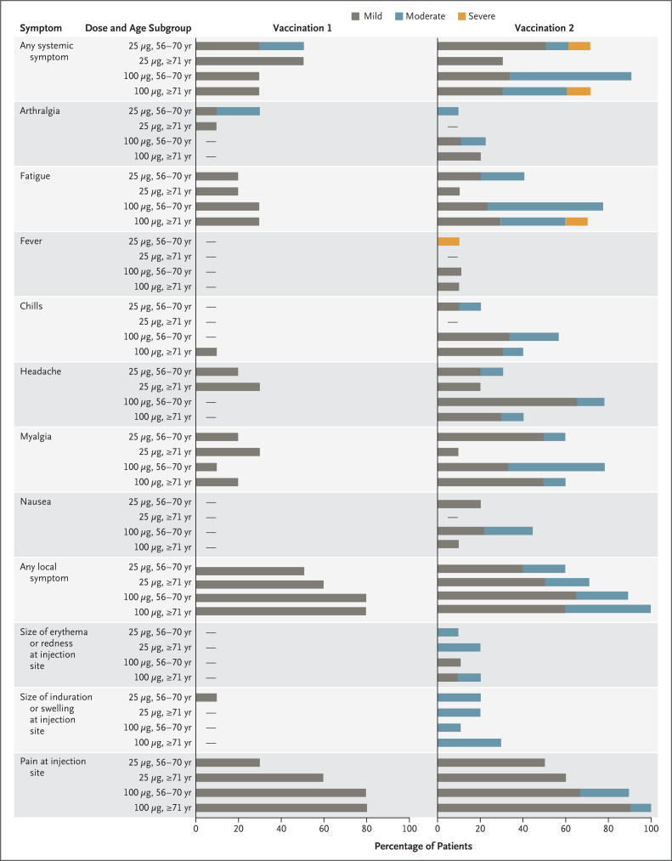
Status: Vaccine Development
Article: Safety and Immunogenicity of SARS-CoV-2 mRNA-1273 Vaccine in Older Adults
(New England Journal of Medicine, September 29, 2020)
Figure 1. Solicited Systemic and Local Adverse Events within 7 Days after Receipt of mRNA-1273.
(These are phase 1 data for Moderna’s vaccine)

Slide 29
Status: Vaccine Development
Status: Moderna mRNA-1273
Source: Moderna Press Release – Phases 3 Data (Nov. 30, 2020)
Primary efficacy analysis of the Phase 3 COVE study of mRNA-1273 involving 30,000 participants included 196 cases of COVID-19, of which 30 cases were severe
Vaccine efficacy against COVID-19 was 94.1%; vaccine efficacy against severe COVID-19 was 100%
Efficacy was consistent across age, race and ethnicity, and gender demographics.
mRNA-1273 continues to be generally well tolerated; no serious safety concerns identified to date
Based on prior analysis, the most common solicited adverse reactions included injection site pain, fatigue, myalgia, arthralgia, headache, and erythema/redness at the injection site. Solicited adverse reactions increased in frequency and severity in the mRNA-1273 group after the second dose.
FDA has told Company to expect VRBPAC meeting for mRNA-1273 likely on December 17, 2020

Slide 30
Status: Vaccine Development
Status: Viral-vectored Vaccines
AstraZeneca ChAd-Spike
Started phase 3 clinical trials August 31
On-hold until October 23; subsequently restarted
Phase 1 data:
Reactogenicity: Mostly mild to moderate; first dose had greater reactogenicity
Immunogenicity: Comparable binding and neutralizing antibodies to that of convalescent sera
Safety classified as fine

Slide 31
Status: Vaccine Development
Status: Viral-vectored Vaccines
Janssen Ad26-Spike
Started phase 3 clinical trials September 23
On-hold until October 23; subsequently restarted
Increased to 60,000 trial participants
Single dose
72% of trial participants reported adverse effects – mostly grade 1 to 2 (so mild to moderate); 1% reported grade 3 pain/tenderness
64% reported systemic adverse effects including fatigue, headache, and myalgia
European Medicines Agency has started a rolling review as of December 1, 2020.

Slide 32
Status: Vaccine Development
Status: S-protein-based Vaccines
Novavax NVX-CoV2373
Two doses (day 1 and 21)
Reactogenicity: Mostly mild to moderate (local pain and tenderness; systemic fatigue, headache, myalgias, malaise); greater reactogenicity with second dose
Immunogenicity: Comparable to or better than convalescent sera
Safety – fine
Sanofi/GSK
No published data

Slide 33
Sources
Much of the information from the above presentation was compiled from the following resources:
American College of Medical Toxicology (ACMT):
Webinar: Monitoring Safety of Vaccines
Post-Marketing Safety of Vaccines Approved by the U.S. Food and Drug Administration
Narayan Nair, MD, Director, Division of Epidemiology, Office of Biostatistics and Epidemiology, Center for Biologics Evaluation and Research, U.S. Food and Drug Administration
Webinar: Update on COVID-19 Vaccine Clinical Trials: Are We There Yet? Evan Anderson, MD, Professor, Pediatrics and Medicine, Emory University School of Medicine

Slide 34
Sources
(Continued)
Article: Safety and Immunogenicity of SARS-CoV-2 mRNA-1273 Vaccine in Older Adults (NEJM, September 29, 2020)
Press Release: Pfizer and BioNTech conclude Phase 3 Study of COVID-19 Vaccine Candidate, Meeting All Primary Efficacy Endpoints
Press Release: Moderna Announces Primary Efficacy Analysis in Phase 3 COVE Study for Its COVID-19 Vaccine Candidate and Filing Today with U.S. FDA for Emergency Use Authorization

Slide 35
Overcoming Vaccine Hesitancy
Must overcome the perception that the vaccines are political in nature
This was never true thanks to the leadership of various regulatory bodies
Same rigorous trial requirements pre-COVID, just now in the public spotlight
Study protocols available to scrutinize by entirety of medical science community
Clear guidelines set forth by the FDA for a vaccine candidate to be considered for an Emergency Use Authorization
Large number of individuals required to be enrolled AND followed up on for at least 2 months post regimen
Data is sliced and diced
Astra Zeneca will do follow-up studies to determine exact dosing regimen
ACIP committee meetings are being held publically
Cost
Any vaccine purchased by the government is free
Operation Warp Speed goal = 300 million doses purchased

Slide 36
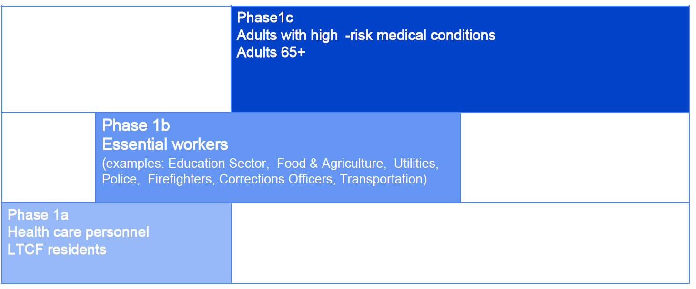
The Logistics of Distribution - What
Two manufacturers have submitted for mRNA vaccine candidates
Pfizer/BioNTech submission for EUA 11/20/2020
Moderna submission for EUA 11/30/2020
There will only be an estimated 40 million doses available initially
40 million doses = 20 million individuals
CDC/NIH charged an independent panel of scientists to develop a fair and impactful distribution plan released on 9/1/2020
With the advent of submissions for EUA, ACIP held an emergency meeting to discuss a recommendation for Phase 1a distribution
https://www.cdc.gov/vaccines/acip/meetings/index.html

Slide 37
The Logistics of Distribution - Who
ACIP Recommendation passed on 12/1/2020 by a vote of 13-1 to include Healthcare Personnel AND Long Term Care Facility residents
Ultimately, distribution will be decided by each jurisdiction
Health care personnel were noted to include all employees of these facilities
Final recommendation will include a clearer definition of long-term care facility, but namely, facilities that provide medical/personal care to elderly

Slide 38
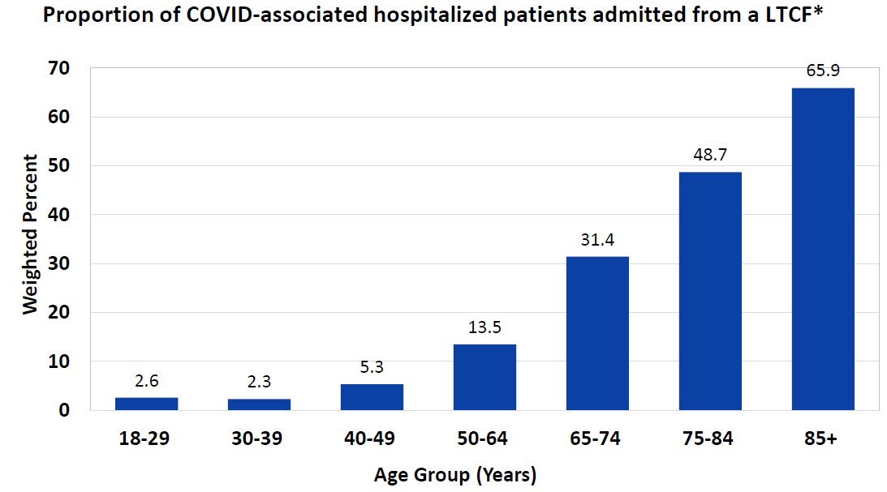
The Logistics of Distribution - Why
Health Care Personnel
As of 12/6/2020 there have been at least 253,507 confirmed cases among HCPs, with 874 deaths
More cases and deaths have been shown to be averted by vaccinating staff
Staff are much more mobile inter- and intra-facility than residents
HCP staffing already affected by absenteeism due to quarantine, infection, and illness.
Residents
LTC residents account for only 6% of the cases, but 40% of the deaths in the U.S.
The majority of COVID-associated hospitalized patients older than 75 years, were admitted from a LTCF
https://covid.cdc.gov/covid-data-tracker/#health-care-personnel

Slide 39
The Logistics of Distribution - How
Vaccine Information Sheet will be replaced by the EUA Fact-Sheet when a vaccine candidate is authorized
Understand sub-prioritization may need to occur based on limited initial supply
Guidance will be forthcoming from jurisdictions as this is part of their planning process
Example sub-prioritization
Personnel without known infection in prior 90 days
Skilled nursing facilities before residential care communities
“ Vaccine will hurt” headlines
Reactogenic symptoms are more common after second dose, but less common in older individuals
May need to stagger HCPs or plan for personnel to have time away from clinical care if HCP experience systemic symptoms post-vaccination
Implementation will still be challenging in spite of multiple clinics at individual sites due to high rate of resident turnover
Explains why the Federal Pharmacy Partnership for Long-Term Care Program is important – IIS Reporting
Notes:
Where sub-prioritization of health care personnel is needed, consider:
Individuals with direct patient contact and unable to telework:
Personnel who provide services to patients or patients' family members
Personnel who handle infectious materials
Can include inpatient or outpatient settings
Personnel working in residential care or long-term care facilities
Personnel without known infection in prior 90 days
Reinfection appears uncommon during the initial 90 days after symptom onset of preceding infection
Serologic testing not recommended prior to vaccination

Slide 40
Continuous Safety Review
Pfizer/BioNTech received approval in the U.K. on 12/2/2020
Surveillance of side effects will be closely watched by US FDA
Multiple adverse event monitoring modalities in the U.S. make for a veritable alphabet soup
VAERS, ADERS, VAECS, NHSN, V-safe, VSD, FDA-CMS, BEST, PRISM, DMSS, Pharmacy Partnership Program,etc.
VAERS - Vaccine Adverse Event Reporting System
VAERS is a long-standing established safety monitoring system that is critical to monitoring new vaccines during the early uptake period and acts as an early warning system for vaccine safety
One of many venues to report adverse effects for residents and HCPS
V-Safe
Text-message and web-survey based system intended for HCP who receive vaccine
RCA - Rapid Cycle Analysis
CMS and VA claims will be monitored for 65+ for safety signals

Slide 41
Build Support
Only safe and effective COVID-19 vaccines that have been rigorously tested in large, well-designed studies with tens of thousands of volunteers will be available.
COVID-19 vaccines are following the same rigorous, multi-phased testing process as every other vaccine.
COVID-19 vaccine development is moving faster than normal because our top medical experts have made it their highest priority, not because steps in the testing process are being skipped.
The FDA will share information about authorized or approved COVID-19 vaccines so you can see the scientific evidence for yourself.
COVID-19 vaccine developers are trying to make sure their clinical trials reflect the nation's diversity, because these vaccines must be proven safe and effective for everyone.
Medical experts and career public health officials, not politicians or their appointees, will decide when a COVID-19 vaccine is safe, effective, and ready for public use.

Slide 42
Questions

